Slide 1


IS204
System Analysis and Design
Software Development Activities
Identify The problem
COMPUTER INFORMATION SYSTEM DEPARTMENT ASS.LEC. ZAINAB H. ALFAYEZ

Slide 2
Software Development Activities
Reminder of the six core processes of the SDLC:
2. Plan and monitor the project—what to do, how to do it, and who does it.
3. Discover and understand the details of the problem or the need
4. Design the system components that solve the problem or satisfy the need.
5. Build, test, and integrate system components.
6. Complete system tests and then deploy the solution
1. Identify the problem or need and obtain approval to proceed.
COMPUTER INFORMATION SYSTEM DEPARTMENT ASS.LEC. ZAINAB H. ALFAYEZ

Slide 3

Identify Problem Activities
Identify the problem.
Quantify project approval factors.
Perform risk and feasibility analysis.
Review with the client and obtain approval.
COMPUTER INFORMATION SYSTEM DEPARTMENT ASS.LEC. ZAINAB H. ALFAYEZ

Slide 4

Identify the Problem
Information system development projects are initiated for various reasons:
1) to respond to an opportunity
2) to resolve a problem, and
3) to respond to an external directive
COMPUTER INFORMATION SYSTEM DEPARTMENT ASS.LEC. ZAINAB H. ALFAYEZ

Slide 5
Identify the Problem
An effective way to define the problem is to develop a System Vision Document.
System Vision Document: a document to help define the scope of a new system.
It contains:
The problem description.
The anticipated business benefits (tangible & intangible)
The system capabilities.
COMPUTER INFORMATION SYSTEM DEPARTMENT ASS.LEC. ZAINAB H. ALFAYEZ

Slide 6
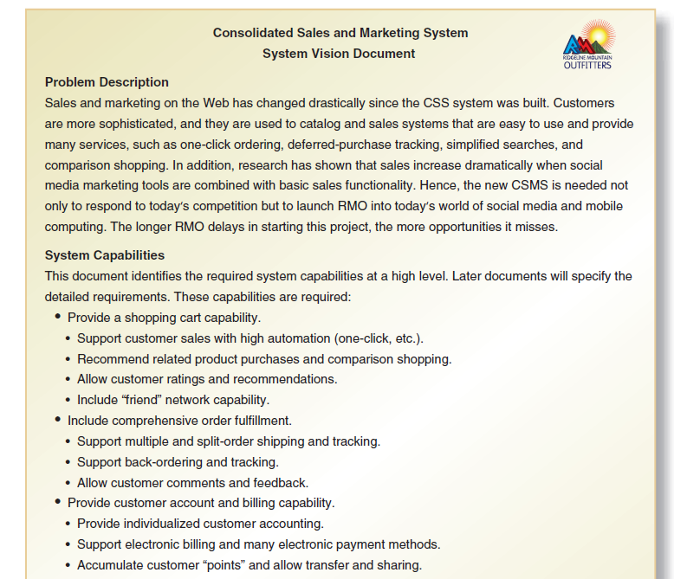
System Vision Document Example
COMPUTER INFORMATION SYSTEM DEPARTMENT ASS.LEC. ZAINAB H. ALFAYEZ

Slide 7
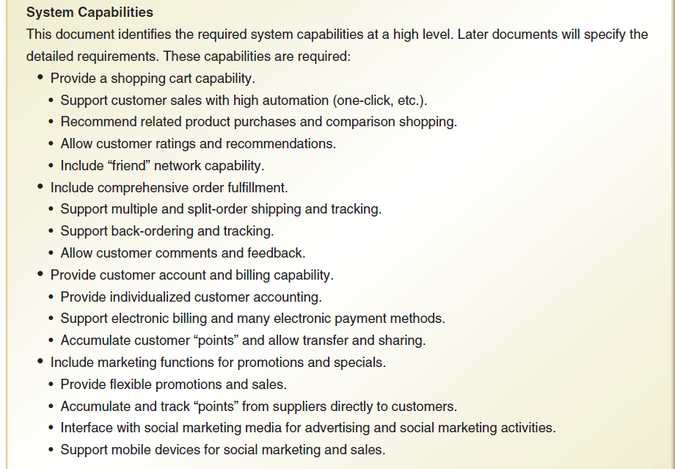
COMPUTER INFORMATION SYSTEM DEPARTMENT ASS.LEC. ZAINAB H. ALFAYEZ

Slide 8
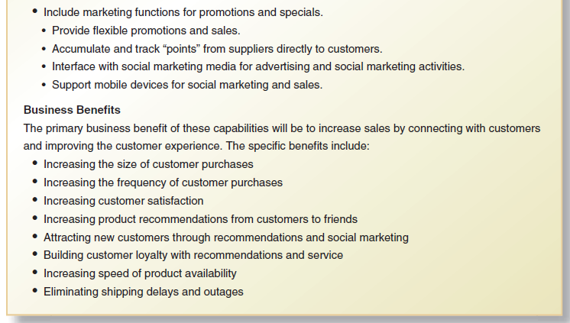
System Vision Document Example
COMPUTER INFORMATION SYSTEM DEPARTMENT ASS.LEC. ZAINAB H. ALFAYEZ

Slide 9
System Vision Document Examples
Write the vision documents for the following systems or subsystems:
1) In order to increase the university of Basrah website visitors, lecturers are demanded to upload video lecturers on their personal pages.
2)
COMPUTER INFORMATION SYSTEM DEPARTMENT ASS.LEC. ZAINAB H. ALFAYEZ

